Slide 1
Analytics on streaming data from
Environmental Sensors
Rajrup Ghosh (M Tech CDS)
Shib Shankar Das (M Tech ECE)

Slide 2
Streams Everywhere
Internet and Social Networks generate streams of posts, hashtags, videos, etc
Twitter, Facebook, Internet packets
Business
Stock market prediction
Monetary Transactions
Cybersecurity
Telecom call logs,
financial transactions, Malware
Internet of Things
Smart Transport, Power and smart grids
Weather forecast and Pollutant monitoring
Smart phone, Health appliances, TV

Slide 3
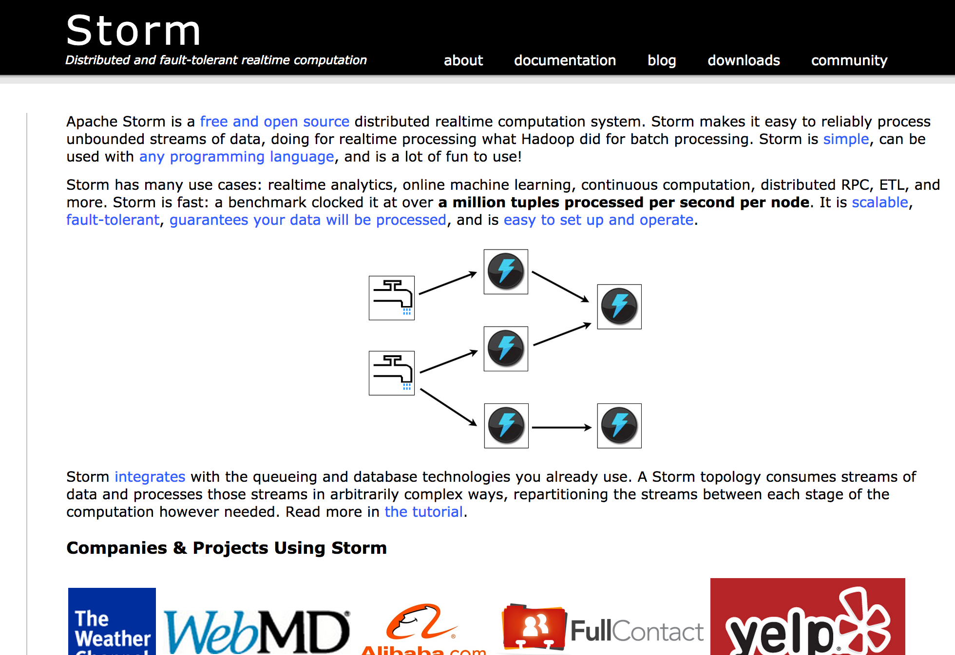

Apache Storm
Originally developed by Nathan Marz at Backtype/Twitter
Distributed, fault-tolerant stream-processing platform
http://storm.apache.org/

Slide 4
Storm Cocepts
Tuples and Streams
Spouts, Bolts, Topologies
Tasks and Workers
Stream Grouping
http://storm.apache.org/releases/current/Tutorial.html

Slide 5
Tuples and Streams
Tuple: ordered list of elements
Stream: unbounded sequence of tuples
Tuple
<sensor ID, value>
(123fsjdhfw, 12.3567)
<sensor ID, value>
(634fvgsdhw, 34.2674)
<sensor ID, value>
(409hjgsadh, 23.6748)
Stream

Slide 6
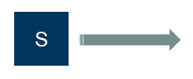
Spouts
The sources of streams
Can talk with
Queues (Kafka, Kestrel, etc.)
Web logs
API calls
Filesystem (MapReduce-FS / HDFS)

Slide 7
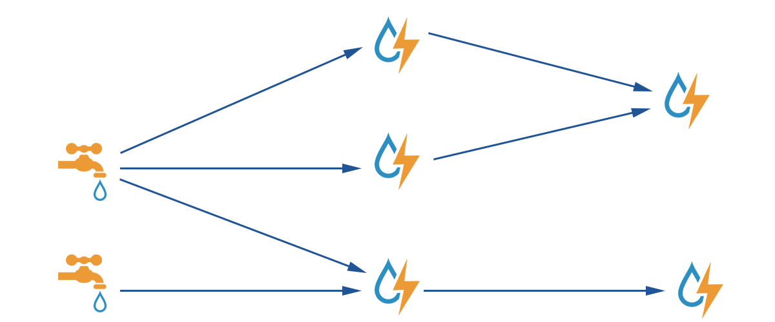
Bolts
Process tuples and create new streams
Implement business logic via …
Transform
Filter
Aggregate
Join
Access datastores & DBs
Access APIs (e.g., geo location look-up)
Bolt
Bolt
Bolt
Bolt
Bolt
TOPOLOGY - Directed graph of spouts and bolts

Slide 8
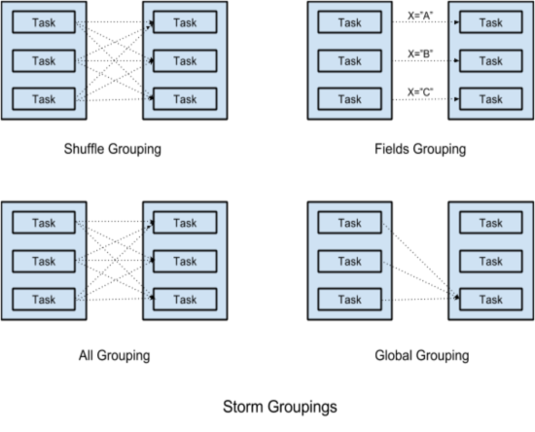
Stream Grouping
Shuffle grouping: tuples are randomly
distributed across all of the tasks
running the bolt
Fields grouping: groups tuples
by specific name field and routes to
the same task

Slide 9
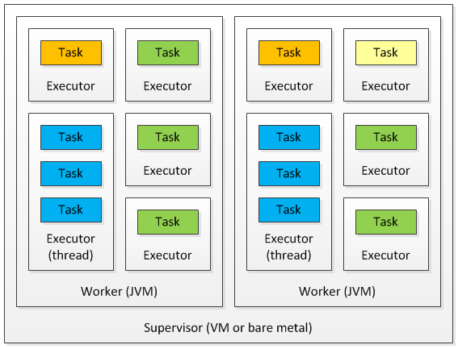
Tasks and Workers
Task: each spout/bolt executes as
many threads of execution across the
cluster
Worker: a physical JVM that executes
a subset of all the tasks for the topology

Slide 10
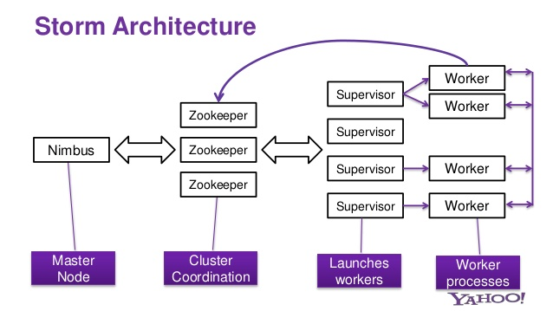
Storm Architecture

Slide 11
Storm Architecture
DataStreamGeneratorSpout
FilterBolt : Kalman Filter
BuildParameterBolt (mean,standard deviation,second moment,third moment)
Used Alon-Matias-Szegedy Algorithm for moment estimation
FileWriterBolt
DataEstimatorSpout
DataWriterBolt

Slide 12



Topology
DataStreamSpout
FilterBolt
BuildParameterBolt
FileWriterBolt
Disk
ForecastSpout
FileWriterBolt
Disk

Slide 13
Alon-Matias-Szegedy Algorithm
Pick random element
Store the element with a count 1
If existing element found in further data increase count
Estimated Second moment = n*(2*X.value-1)
Estimated Third moment= n*(3*v^2-3*V+1)

Slide 14
Forecasting
Forecasting is a process of estimation of an unknown event/parameter such as demand for a product, amount of rainfall, etc.
Forecasting is commonly used to refer timeseries data.
Time Series is a sequence of data points measured at successive time intervals.
Time series analysis helps to identify and explain:
Any systematic variation in the series of data which is due to seasonality.
Cyclical pattern that repeat.
Trends in the data.
Growth rates in the trends.

Slide 15


Additive and Multiplicative Models
1. Additive Forecasting Model
2. Multiplicative Forecasting Model
Trend Seasonality Cylical Random
Trend Seasonality Cylical Random

Slide 16
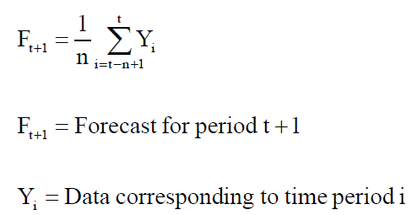

Time Series Techniques
Moving Average.
Simple moving average
Weighted moving average
Exponential Smoothing.
Auto-regression Models (AR Models)
ARIMA (Auto-regressive Integrated Moving Average) Models

Slide 17


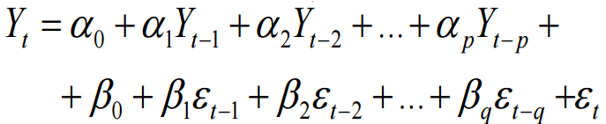
AR(p), MA(q) and ARMA(p, q)
Auto-Regressive Process: AR(p) process models each future observation as a function “p” previous observations. If {Y_{t}} is purely random with mean zero and constant standard deviation σ (White Noise). Then the autoregressiv AR(p) process:
Moving Average Process: MA(q) models each future observation as a function of “q” previous errors. If {Y_{t}} is a moving average process of order q (MA(q)) if for some constants β₀, β₁, …, β_{q}
ARMA(p,q) model is a combination of AR(p) and MA(q) process, given by -

Slide 18
ARIMA (p, d, q)
ARIMA has the following three components:
Auto-regressive component (p): Function of past values of the time series.
Integration Component (d): Differencing the time series to make it a stationary process.
Moving Average Component (q): Function of past error values.
The q and p values are identified using auto-correlation function (ACF) and Partial auto-correlation function (PACF) respectively. The value d identifies the level of differencing.
Box-Jenkins Methodology is used to identify the model parameters.

Slide 19
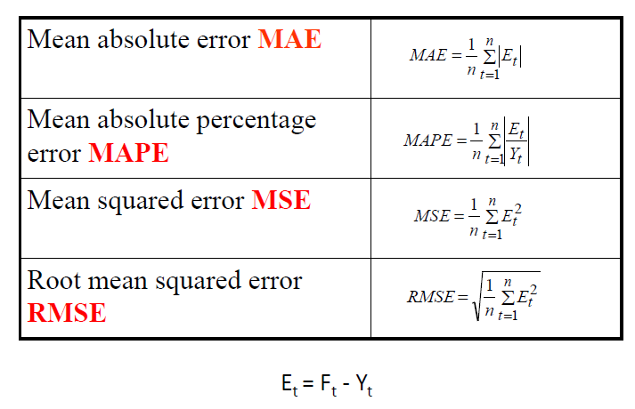
Measures of aggregate error

Slide 20

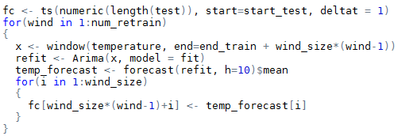
What we have used?
R forecast package has been used (developed by Hyndman & Khandakar (JSS, 2008). We have used JRI for R function calls from Java.
We have used auto.arima( ) function to estimate ARIMA(p, d, q) parameters, with learning seasonal parameters as well
We have trained a part of the dataset, and used multi-step forecast with re-estimation for the test data in streaming environment.
Test Code
Train Code

Slide 21
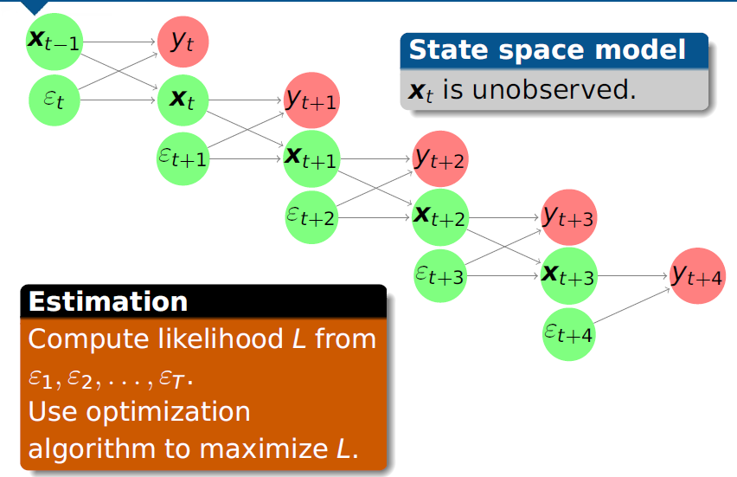
Time series forecasting

Slide 22
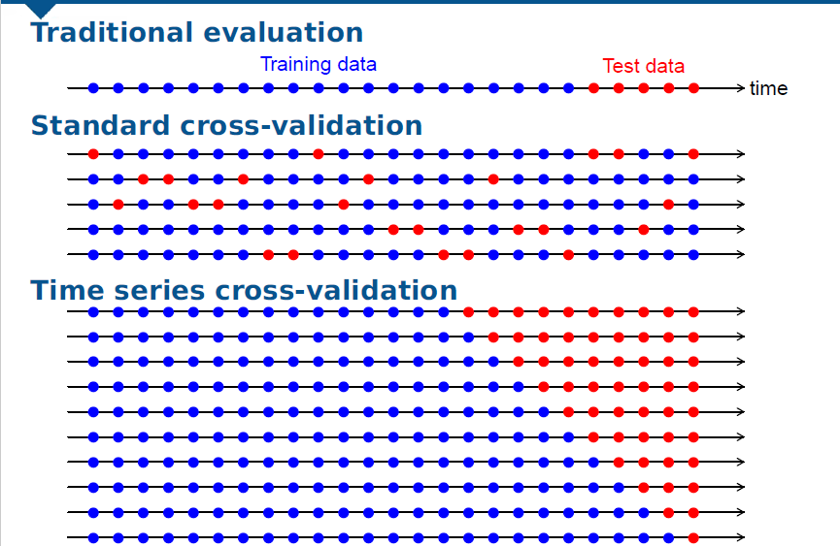

Time Series Cross-validation

Slide 23
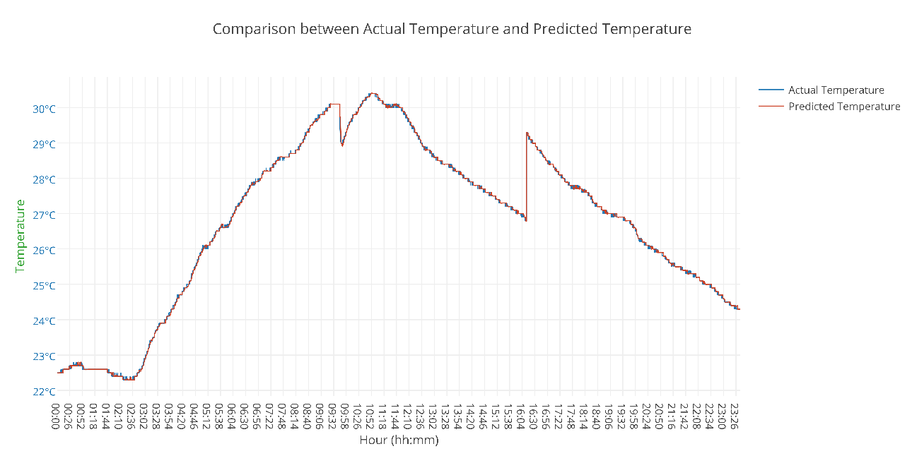
Results
RMSE: 0.124
MAPE: 0.310
MAE: 0.050
Dataset: Data Canvas Sensor Data [2]

Slide 24
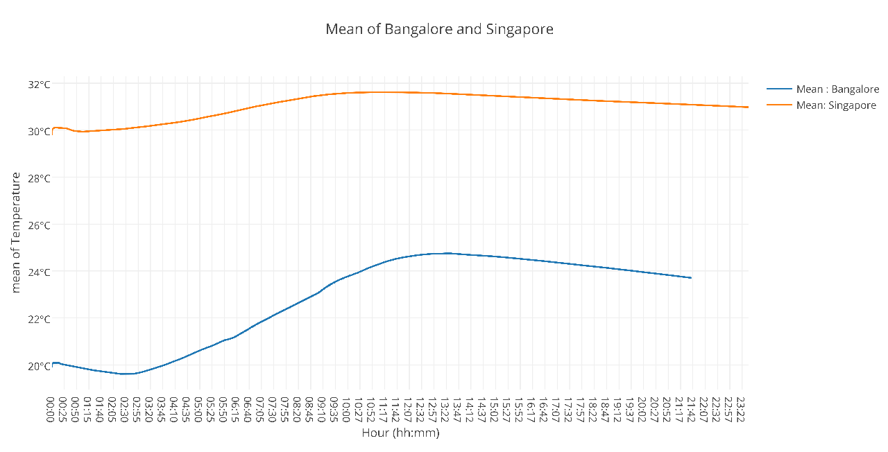

Slide 25
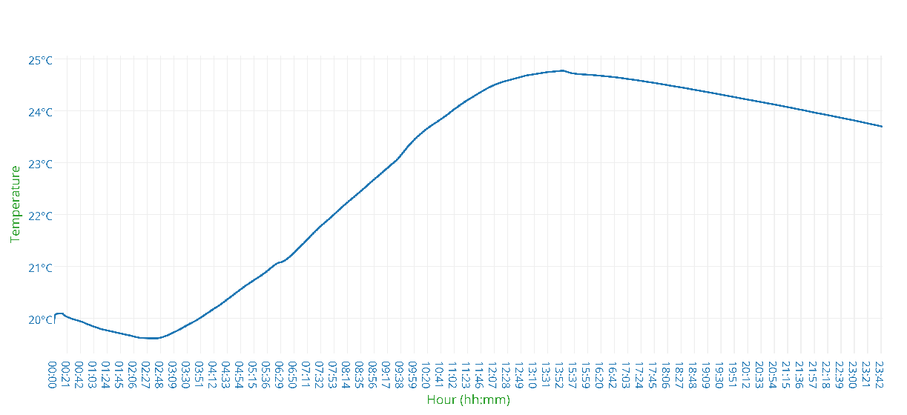
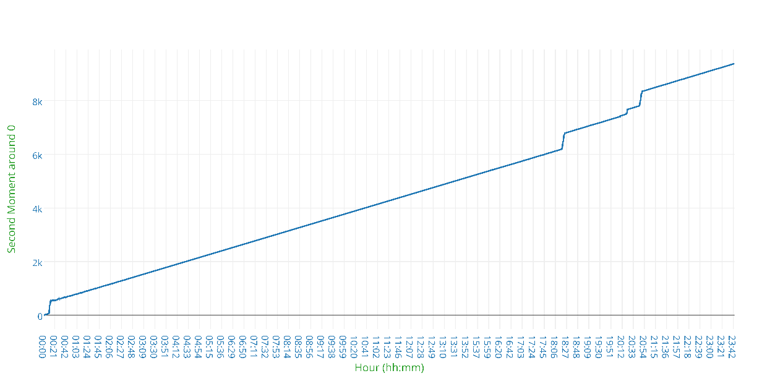
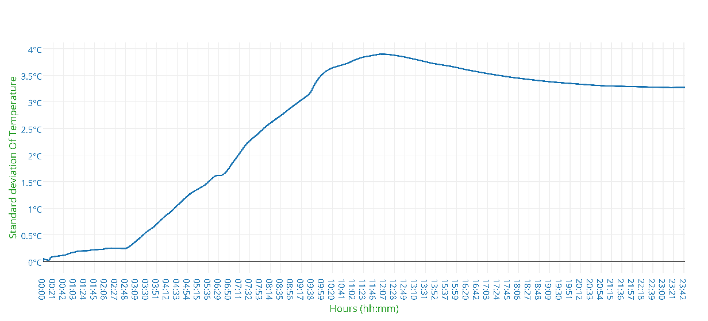
Comparison of Mean, Standard deviation, second moment about 0 (in degree Celsius) for temperature in Bangalore

Slide 26
Conclusion
In this project we have learned real-time analytics over high velocity streaming data
Apache Storm scaled nicely with different input stream rates for performing statistical analysis on the sensor data.
It can be observed from the results obtained that forecasting for weather data worked very well using auto.arima( ) with periodic retraining.
All these study has a huge application in weather stations and pollution monitoring centers for dealing with numerous sensor data and is of a growing importance in developing future “SMART CITIES”.

Slide 27
Future Work
Due to lack of JAVA based implementation of ARIMA, we used R packages which have some overhead on end to end latency for streaming applications.
ARIMA and auto.arima( ) can be implemented in JAVA so the strom application can better scale with forecasting, decreasing the end to end latency as a whole.
Another important study may involve comparison with different forecasting methods and how they scale with streaming applications.
Deploy a statistical package (maybe query based) for real-time analytics of streaming data coming from weather stations and pollution monitoring centers.

Slide 28
References
A. Toshniwal, S. Taneja, A. Shukla, K. Ramasamy, J. M. Patel, S. Kulkarni, J. Jackson, K. Gade, M. Fu, J. Donham, N. Bhagat, S. Mittal, and D. Ryaboy, “Storm@twitter,” in Proceedings of the 2014 ACM SIGMOD International Conference on Management of Data
D. Canvas, “Data Canvas Dataset,” url: http://datacanvas.org/sense-your-city/, 2015..
A. Rajaraman and J. D. Ullman, Mining of Massive Datasets. New York, NY, USA: Cambridge University Press, 2011.
G. E. P. Box and G. Jenkins, Time Series Analysis, Forecasting and Control. Holden-Day, Incorporated, 1990.
R. J. Hyndman and Y. Khandakar, “Automatic time series forecasting: the forecast package for R,” Journal of Statistical Software, vol. 26, no. 3, pp. 1–22, 2008.
Y. Sakamoto, M. Ishiguro, and G. Kitagawa, Akaike information criterion statistics, ser. Mathematics and its applications. Japanese series. Tokyo: KTK Dordrecht, 1986, includes index.

